Slide 1
Digital Image Processing
Morphological Image Processing

Slide 2
Contents
Once segmentation is complete, morphological operations can be used to remove imperfections in the segmented image and provide information on the form and structure of the image
In this lecture we will consider
  What is morphology?
  Simple morphological operations
  Compound operations
  Morphological algorithms

Slide 3
1, 0, Black, White?
Throughout all of the following slides whether 0 and 1 refer to white or black is a little interchangeable
All of the discussion that follows assumes segmentation has already taken place and that images are made up of 0s for background pixels and 1s for object pixels
After this it doesn’t matter if 0 is black, white, yellow, green…….

Slide 4
What Is Morphology?
Morphological image processing (or morphology) describes a range of image processing techniques that deal with the shape (or morphology) of features in an image
Morphological operations are typically applied to remove imperfections introduced during segmentation, and so typically operate on bi-level images

Slide 5
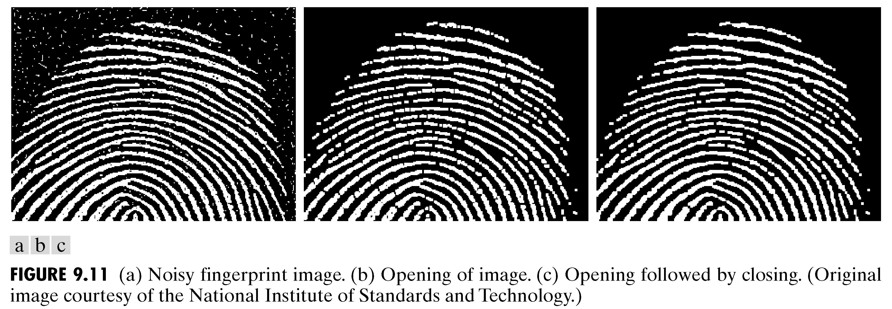
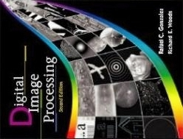
Quick Example
Images taken from Gonzalez & Woods, Digital Image Processing (2002)
Image after segmentation
Image after segmentation and morphological processing

Slide 6
Structuring Elements, Hits & Fits
B
Structuring Element
Fit: All on pixels in the structuring element cover on pixels in the image
Hit: Any on pixel in the structuring element covers an on pixel in the image
A
C
All morphological processing operations are based on these simple ideas

Slide 7
Structuring Elements
Structuring elements can be any size and make any shape
However, for simplicity we will use rectangular structuring elements with their origin at the middle pixel
0 | 0 | 1 | 0 | 0
0 | 1 | 1 | 1 | 0
1 | 1 | 1 | 1 | 1
0 | 1 | 1 | 1 | 0
0 | 0 | 1 | 0 | 0
1 | 1 | 1
1 | 1 | 1
1 | 1 | 1
0 | 1 | 0
1 | 1 | 1
0 | 1 | 0

Slide 8
Fitting & Hitting
0 | 0 | 0 | 0 | 0 | 0 | 0 | 0 | 0 | 0 | 0 | 0
0 | 0 | 0 | 1 | 1 | 0 | 0 | 0 | 0 | 0 | 0 | 0
0 | 0 | 1 | 1 | 1 | 1 | 1 | 0 | 0 | 0 | 0 | 0
0 | 1 | 1 | 1 | 1 | 1 | 1 | 1 | 0 | 0 | 0 | 0
0 | 1 | 1 | 1 | 1 | 1 | 1 | 1 | 0 | 0 | 0 | 0
0 | 0 | 1 | 1 | 1 | 1 | 1 | 1 | 0 | 0 | 0 | 0
0 | 0 | 1 | 1 | 1 | 1 | 1 | 1 | 1 | 0 | 0 | 0
0 | 0 | 1 | 1 | 1 | 1 | 1 | 1 | 1 | 1 | 1 | 0
0 | 0 | 0 | 0 | 0 | 1 | 1 | 1 | 1 | 1 | 1 | 0
0 | 0 | 0 | 0 | 0 | 0 | 0 | 0 | 0 | 0 | 0 | 0
1 | 1 | 1
1 | 1 | 1
1 | 1 | 1
B
C
Structuring Element 1
0 | 1 | 0
1 | 1 | 1
0 | 1 | 0
A
Structuring Element 2

Slide 9
Fundamental Operations
Fundamentally morphological image processing is very like spatial filtering
The structuring element is moved across every pixel in the original image to give a pixel in a new processed image
The value of this new pixel depends on the operation performed
There are two basic morphological operations: erosion and dilation

Slide 10
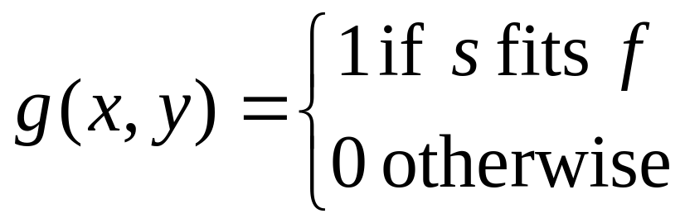
Erosion
Erosion of image f by structuring element s is given by f  s
The structuring element s is positioned with its origin at (x, y) and the new pixel value is determined using the rule:

Slide 11
Erosion Example
Original Image
Processed Image With Eroded Pixels
Structuring Element

Slide 12
Erosion Example
Original Image
Processed Image
Structuring Element

Slide 13

Erosion Example 1
Original image
Erosion by 3*3 square structuring element
Erosion by 5*5 square structuring element
Watch out: In these examples a 1 refers to a black pixel!

Slide 14
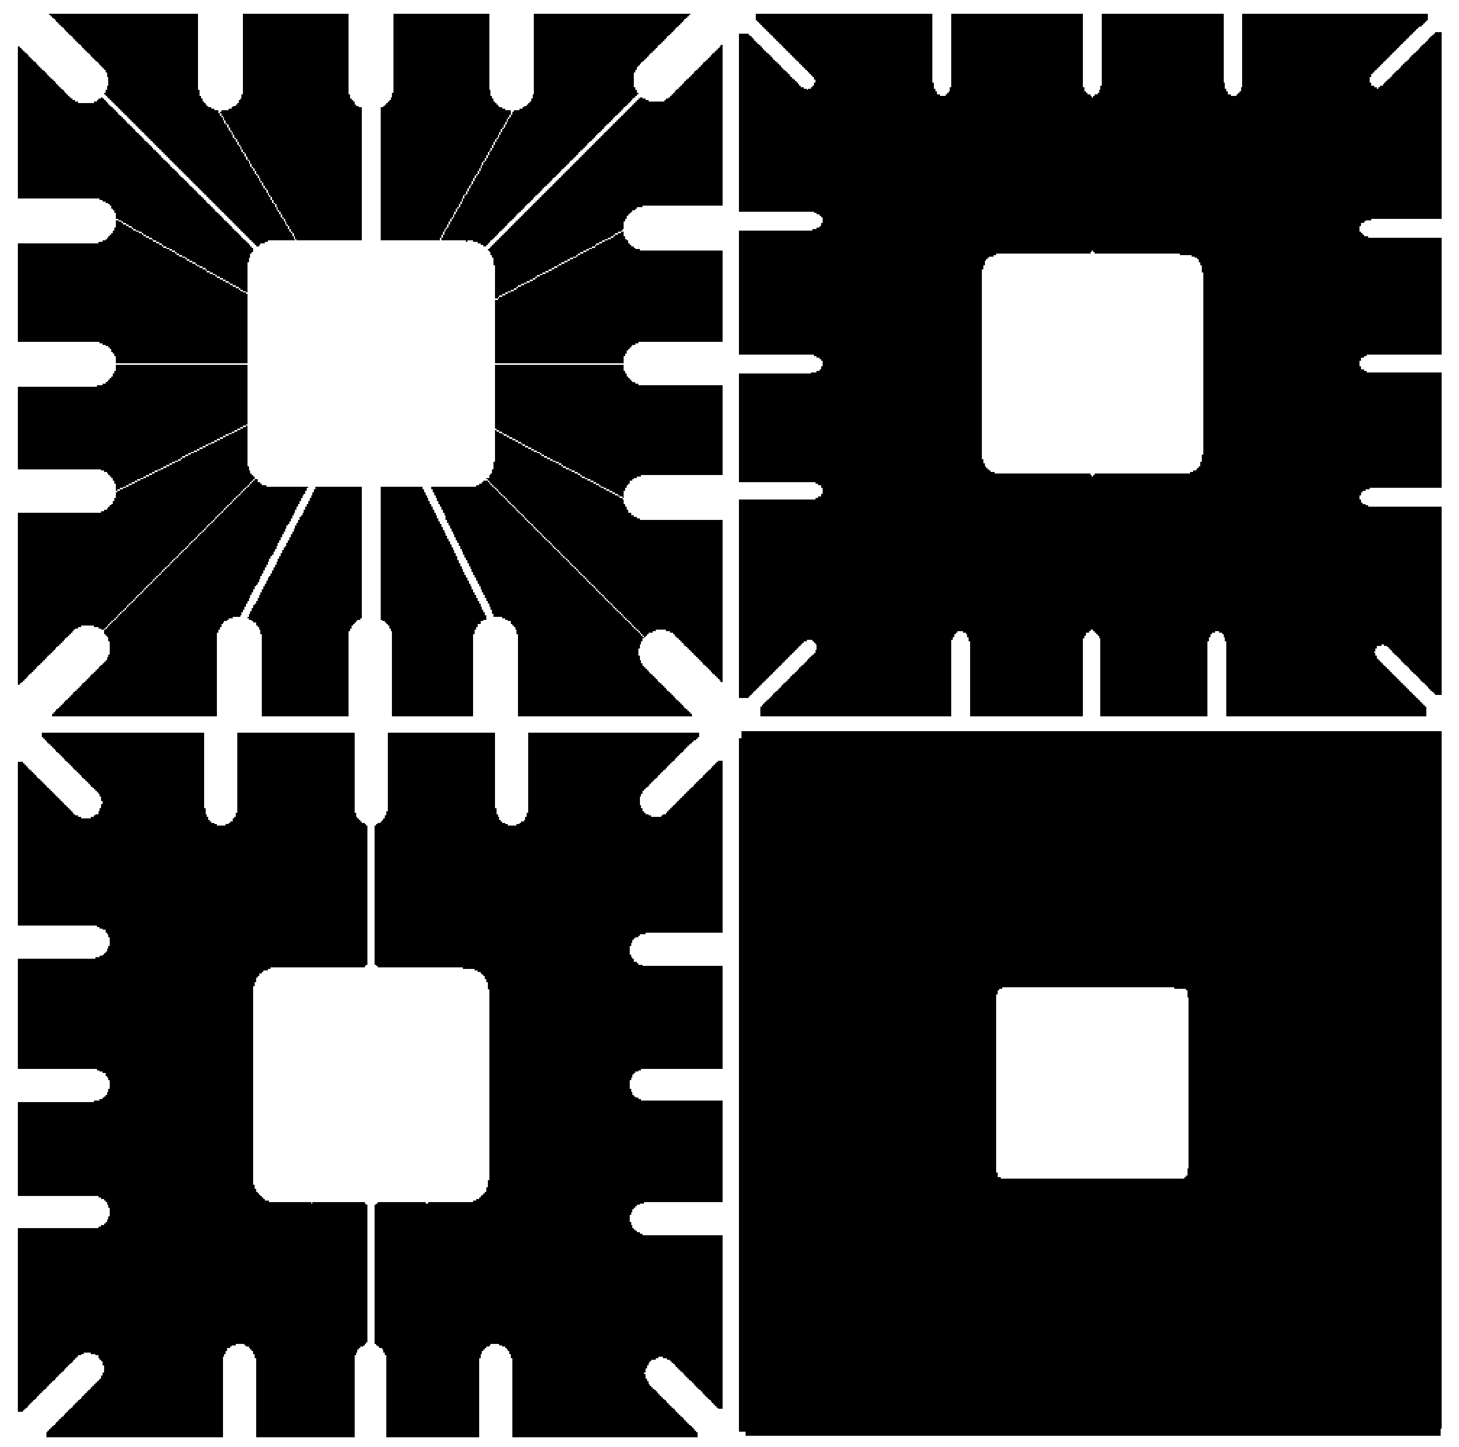
Erosion Example 2
Original image
After erosion with a disc of radius 10
Images taken from Gonzalez & Woods, Digital Image Processing (2002)
After erosion with a disc of radius 5
After erosion with a disc of radius 20

Slide 15
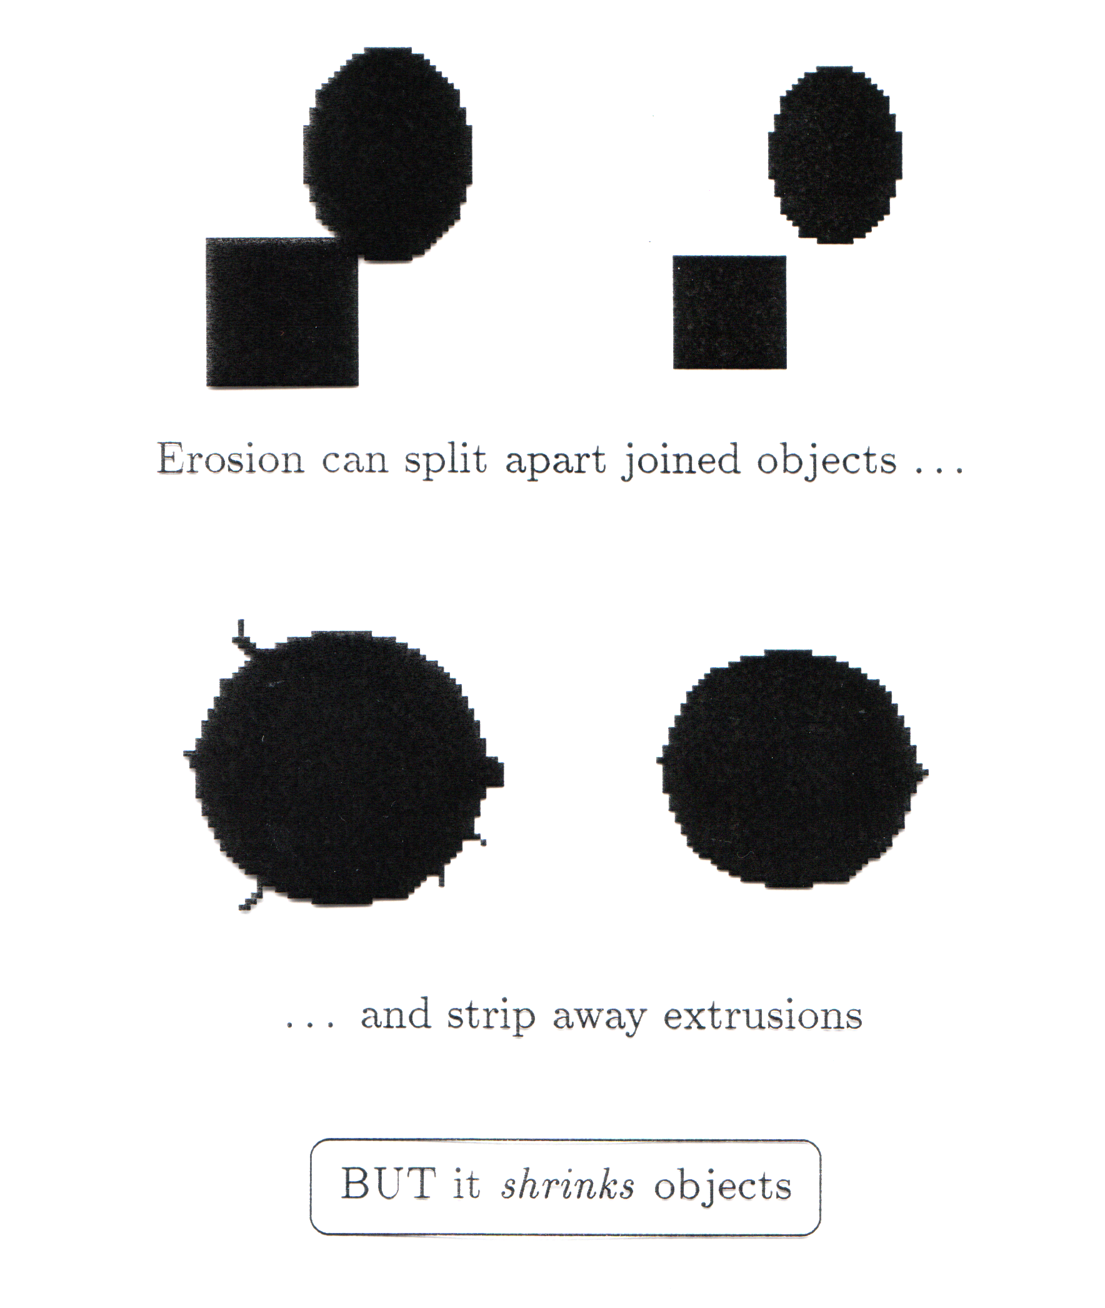
What Is Erosion For?
Erosion can split apart joined objects
Erosion can strip away extrusions
Watch out: Erosion shrinks objects
Erosion can split apart

Slide 16


Dilation
Dilation of image f by structuring element s is given by f s
The structuring element s is positioned with its origin at (x, y) and the new pixel value is determined using the rule:

Slide 17
Dilation Example
Original Image
Processed Image
Structuring Element

Slide 18
Dilation Example
Original Image
Processed Image With Dilated Pixels
Structuring Element

Slide 19

Dilation Example 1
Original image
Dilation by 3*3 square structuring element
Dilation by 5*5 square structuring element
Watch out: In these examples a 1 refers to a black pixel!

Slide 20
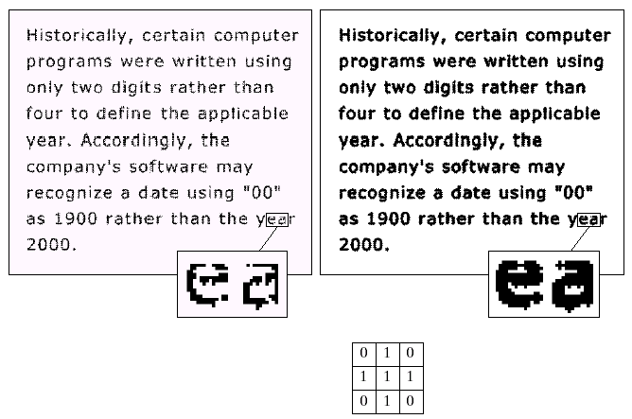
Dilation Example 2
Original image
After dilation
Images taken from Gonzalez & Woods, Digital Image Processing (2002)
Structuring element

Slide 21
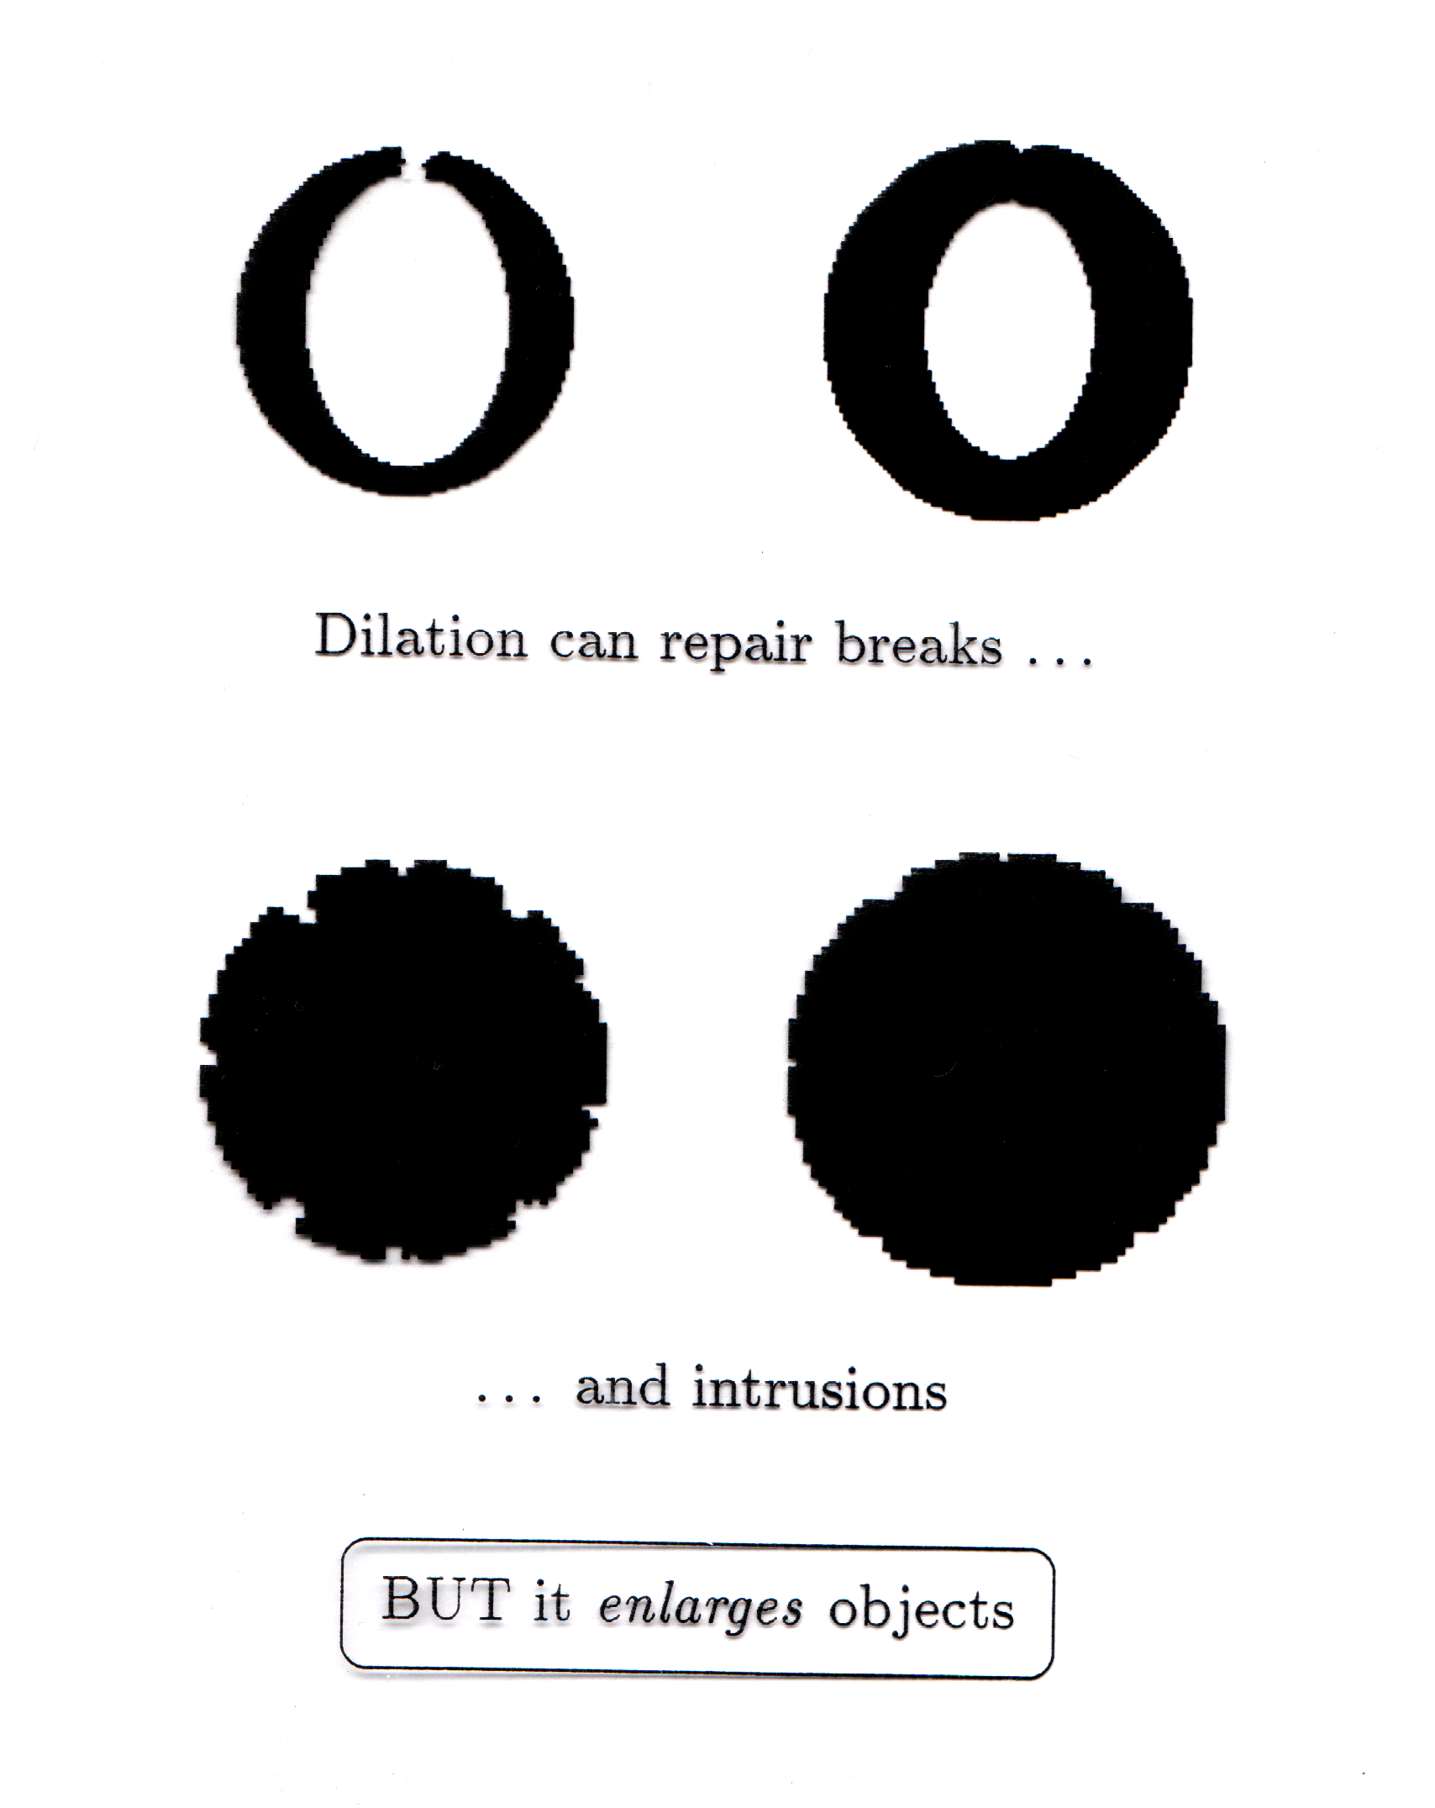
What Is Dilation For?
Dilation can repair breaks
Dilation can repair intrusions
Watch out: Dilation enlarges objects

Slide 22
Compound Operations
More interesting morphological operations can be performed by performing combinations of erosions and dilations
The most widely used of these compound operations are:
  Opening
  Closing

Slide 23
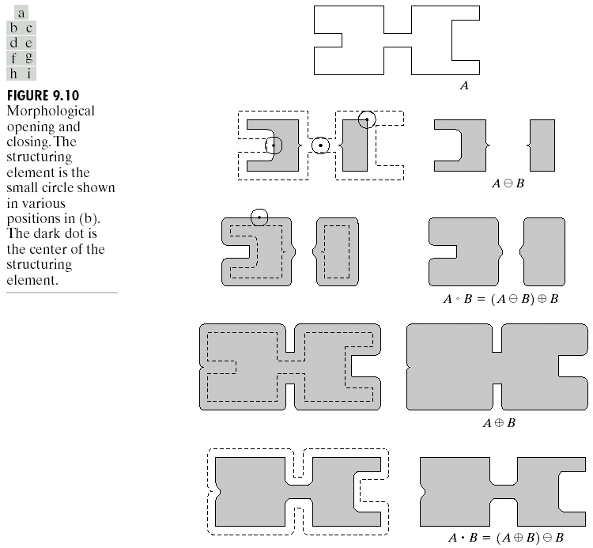
Opening
The opening of image f by structuring element s, denoted f ○ s is simply an erosion followed by a dilation
f ○ s = (f s) s
Images taken from Gonzalez & Woods, Digital Image Processing (2002)
Original shape
After erosion
After dilation
(opening)
Note a disc shaped structuring element is used

Slide 24

Opening Example
Original Image
Images taken from Gonzalez & Woods, Digital Image Processing (2002)
Image After Opening

Slide 25
Opening Example
Original Image
Processed Image
Structuring Element

Slide 26
Opening Example
Original Image
Processed Image
Structuring Element

Slide 27
Closing
The closing of image f by structuring element s, denoted f • s is simply a dilation followed by an erosion
f • s = (f s)s
Images taken from Gonzalez & Woods, Digital Image Processing (2002)
Original shape
After dilation
After erosion
(closing)
Note a disc shaped structuring element is used

Slide 28
Closing Example
Original Image
Images taken from Gonzalez & Woods, Digital Image Processing (2002)
Image After Closing

Slide 29
Closing Example
Original Image
Processed Image
Structuring Element

Slide 30
Closing Example
Original Image
Processed Image
Structuring Element

Slide 31
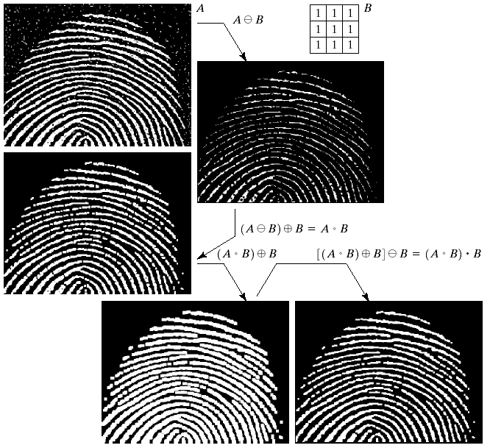
Morphological Processing Example
Images taken from Gonzalez & Woods, Digital Image Processing (2002)

Slide 32
Morphological Algorithms
Using the simple technique we have looked at so far we can begin to consider some more interesting morphological algorithms
We will look at:
  Boundary extraction
  Region filling
There are lots of others as well though:
  Extraction of connected components
  Thinning/thickening
  Skeletonisation

Slide 33
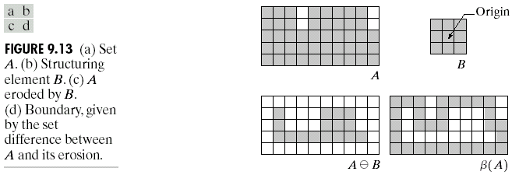
Boundary Extraction
Extracting the boundary (or outline) of an object is often extremely useful
The boundary can be given simply as
β(A) = A – (AB)
Images taken from Gonzalez & Woods, Digital Image Processing (2002)

Slide 34
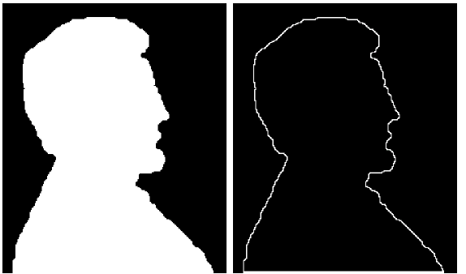
Boundary Extraction Example
A simple image and the result of performing boundary extraction using a square 3*3 structuring element
Images taken from Gonzalez & Woods, Digital Image Processing (2002)
Original Image
Extracted Boundary

Slide 35
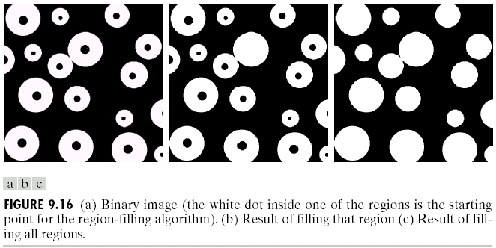
Region Filling
Given a pixel inside a boundary, region filling attempts to fill that boundary with object pixels (1s)
Images taken from Gonzalez & Woods, Digital Image Processing (2002)
Given a point inside here, can we fill the whole circle?

Slide 36
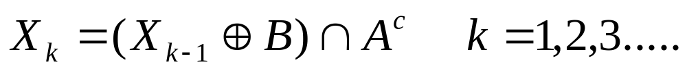
Region Filling (cont…)
The key equation for region filling is
Where X₀ is simply the starting point inside the boundary, B is a simple structuring element and A^{c} is the complement of A
This equation is applied repeatedly until X_{k} is equal to X_{k-1}
Finally the result is unioned with the original boundary
Images taken from Gonzalez & Woods, Digital Image Processing (2002)

Slide 37
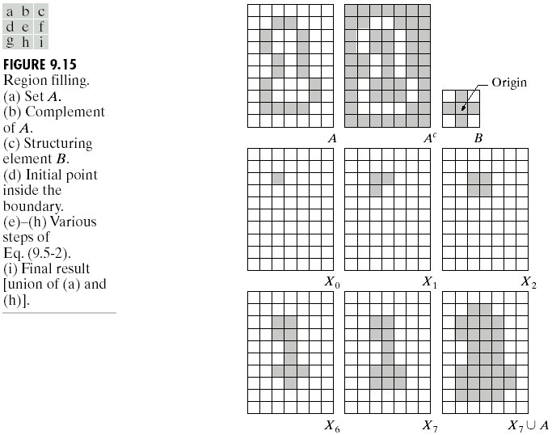
Region Filling Step By Step
Images taken from Gonzalez & Woods, Digital Image Processing (2002)

Slide 38
Region Filling Example
Images taken from Gonzalez & Woods, Digital Image Processing (2002)
Original Image
One Region Filled
All Regions Filled

Slide 39
Summary
The purpose of morphological processing is primarily to remove imperfections added during segmentation
The basic operations are erosion and dilation
Using the basic operations we can perform opening and closing
More advanced morphological operation can then be implemented using combinations of all of these

Slide 40
Structuring Elements, Hits & Fits

Slide 41
HIT!
FIT!

Slide 42
MISS!
MISS!

Slide 43
Erosion Example
Structuring Element

Slide 44
Dilation Example
Structuring Element

Slide 45
Opening Example
Original Image
Processed Image
Structuring Element

Slide 46
Closing Example
Original Image
Processed Image
Structuring Element

Slide 47
Region Filling Step By Step
Images taken from Gonzalez & Woods, Digital Image Processing (2002)

Slide 48
Region Filling Step By Step
Images taken from Gonzalez & Woods, Digital Image Processing (2002)

